Slide 1
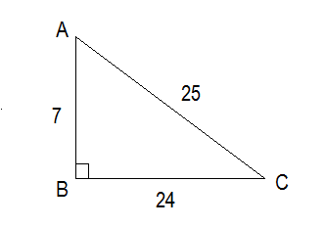
Trig Ratios
SohCahToa
Sine =
Sin A = ___
Sin C = ___

Slide 2
Trig Ratios
SohCahToa
Cosine =
Cos A = ___
Cos C = ___

Slide 3
Trig Ratios
SohCahToa
Tangent =
Tan A = ___
Tan C = ___

Slide 4
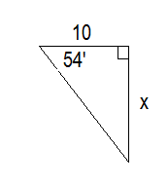
Example #1
Solve for x.

Slide 5
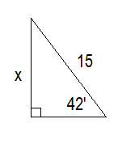
Example #2
Solve for x.

Slide 6
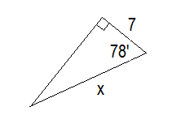
Example #3
Solve for x.

Slide 7
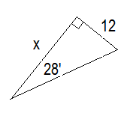
Example #4
Solve for x.

Slide 8
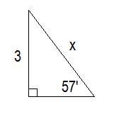
Example #5
Solve for x.

Slide 9
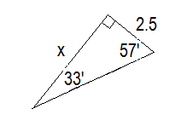
Example #6
Solve for x.

Slide 10
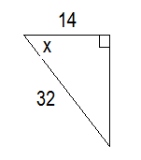
Example #7
Solve for x.

Slide 11
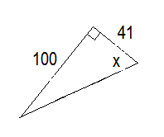
Example #8
Solve for x.

Slide 12
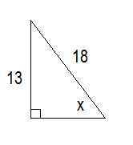
Example #9
Solve for x.

Slide 13
Example #10
To measure the height of a tree, Anna walked 125 ft from the tree and measured a 32° angle from the ground to the top of the tree. Find the height of the tree.

Slide 14
Example #11
A 20-ft wire supporting a flagpole forms a 35° angle with the flagpole. How tall is the flagpole?

